Slide 1
6.2 Shrinkage Methods
January 23, 2015

Slide 2
What are shrinkage methods?
Fit a model with all predictors that shrinks coefficient estimates toward zero
Goal is to reduce variability around coefficients
Two best known shrinkage methods: ridge and lasso

Slide 3
Ridge
Very similar to least squares in that both methods select coefficients that reduce RSS
Two important differences:
Coefficients are estimated by minimizing slightly different entity.
Ridge keeps all variables in model no matter what, i.e. no backwards/forwards selection

Slide 4
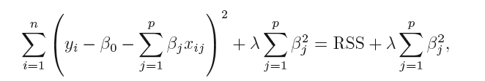
Ridge
Tuning paramter
Shrinkage penalty

Slide 5
Ridge
Shrinkage penalty
Is small when coefficients close to zero
Has the effect of shrinking β_{j} toward zero
Only applied to coefficients, never intercept

Slide 6
Ridge
Tuning parameter
Controls impact of shrinkage penalty
When λ=0, offers same results as least squares
As λ, coefficients approach zero
Ridge offers a different set of coefficients for each value of λ
Selecting a good value for λ is critical

Slide 7
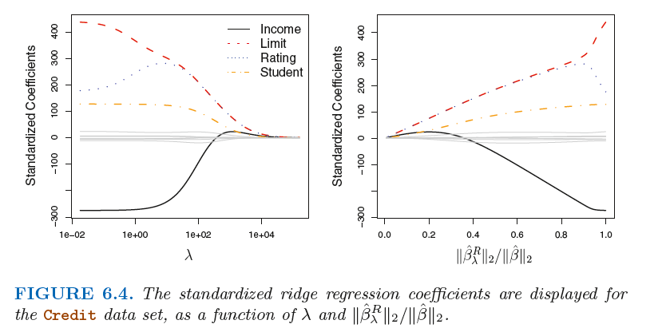
Ridge

Slide 8
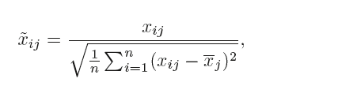
Ridge
Unlike least squares, ridge is very scale dependent
Therefore must standardize coefficients
The following formula will ensure all coefficients have a standard deviation of one

Slide 9
Ridge vs. least squares
Advantage of ridge comes in bias-variance trade-off
As λ increases, bias increases, but variance decreases

Slide 10
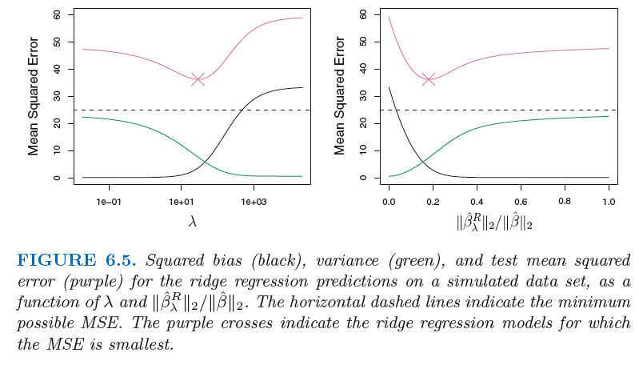
Ridge vs. least squares

Slide 11
The lasso
Alternative to ridge
Allows coefficients to reduce to zero
Doesn’t necessarily include all predictors in model

Slide 12
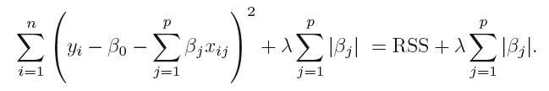
The lasso
Entity lasso minimizes is similar to the entity ridge minimizes
Only difference is uses |β_{j}|, which forces some coefficients to be zero
Performs variable selection
Creates models that are easier to interpret

Slide 13
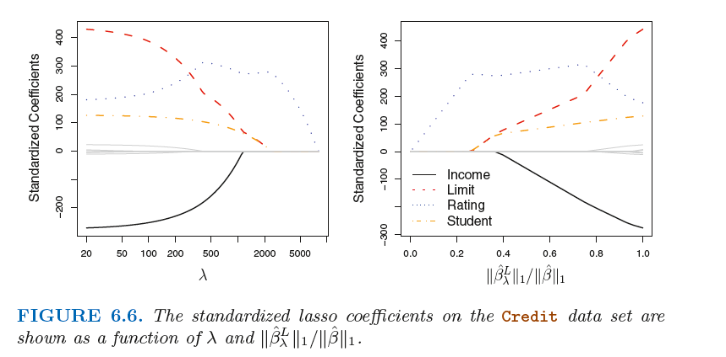
The lasso
As in ridge, selecting correct λ is vital.

Slide 14
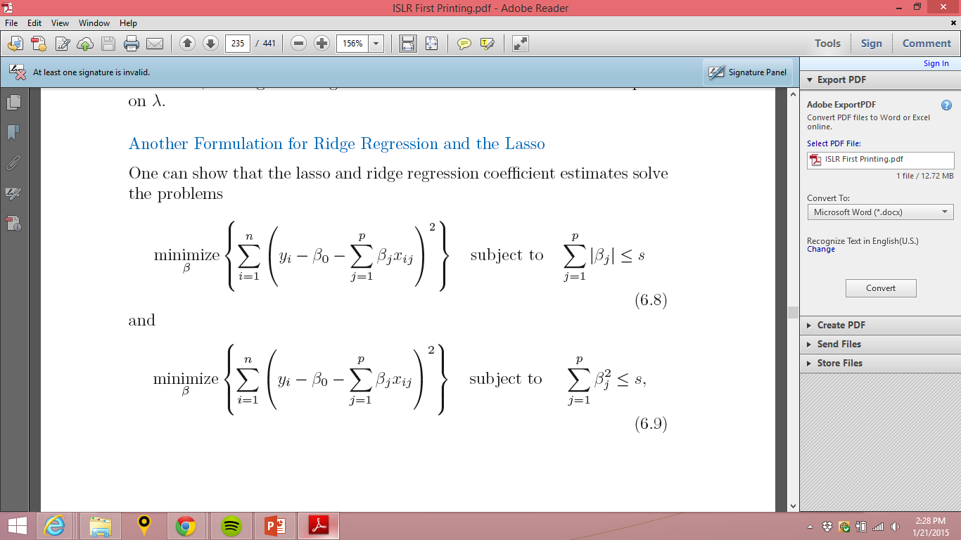
Another Formulation for Ridge Regression and the Lasso

Slide 15
Another Formulation for Ridge Regression and the Lasso
When we perform the lasso we are trying to find the set of coefficient estimates that lead to the smallest RSS, subject to the constraint that there is a budget s for how large can be in the lasso and for ridge.
If s is large, it includes least squares and yields least squares solution
When s is small, for ridge and for lasso must be small.

Slide 16
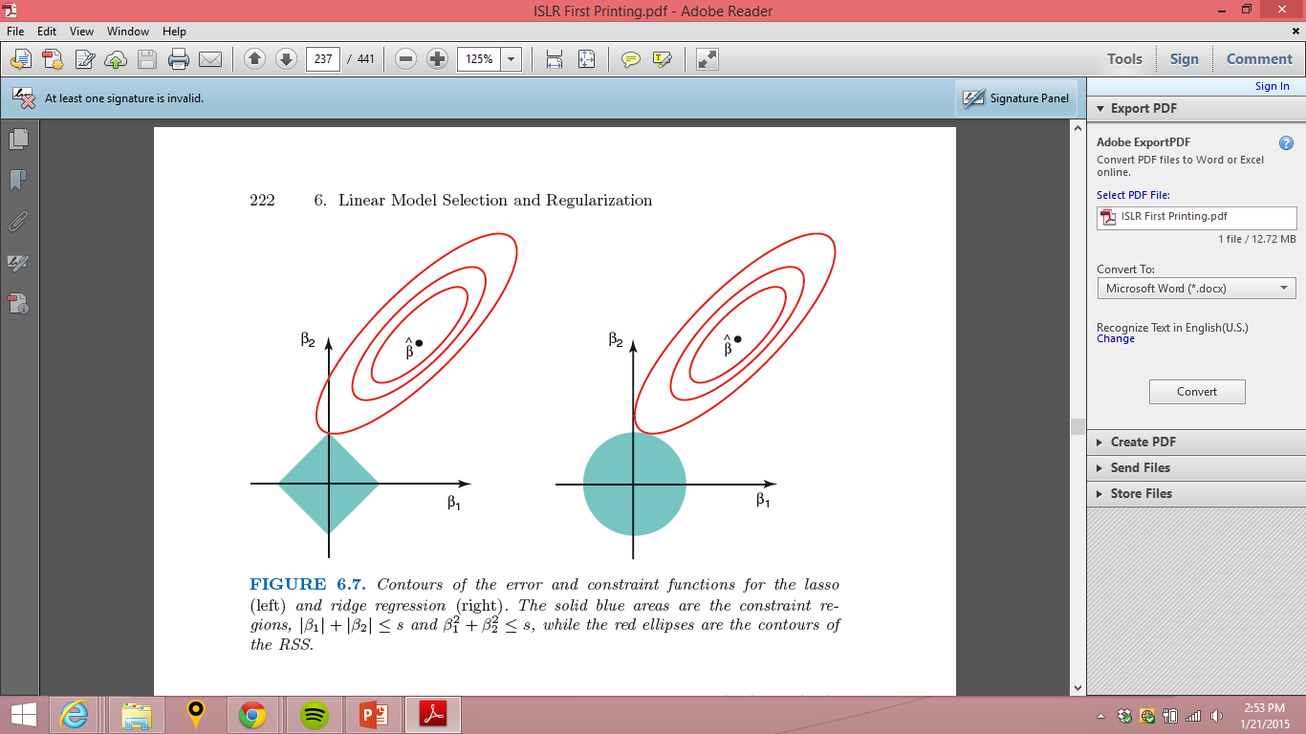
Visual example in model with two predictors
= least squares solution
Point where red ellipses meets blue area = ridge or lasso solution

Slide 17
Lasso vs. ridge
Qualitatively, both give very similar results
For both, as λ increases, variance decreases and bias increases
If all predictors associated with outcome, ridge slightly outperforms lasso
When not all predictors associated with outcome or when some predictors have very large coefficients, lasso slightly outperforms ridge
Ridge regression more or less shrinks every dimension of the data by the same proportion, whereas the lasso more or less shrinks all coefficients toward or to zero by a similar amount
Biggest advantage is lasso performs variable selection, making model interpretation easier
Best to use cross-validation to determine which technique is better for a particular dataset

Slide 18
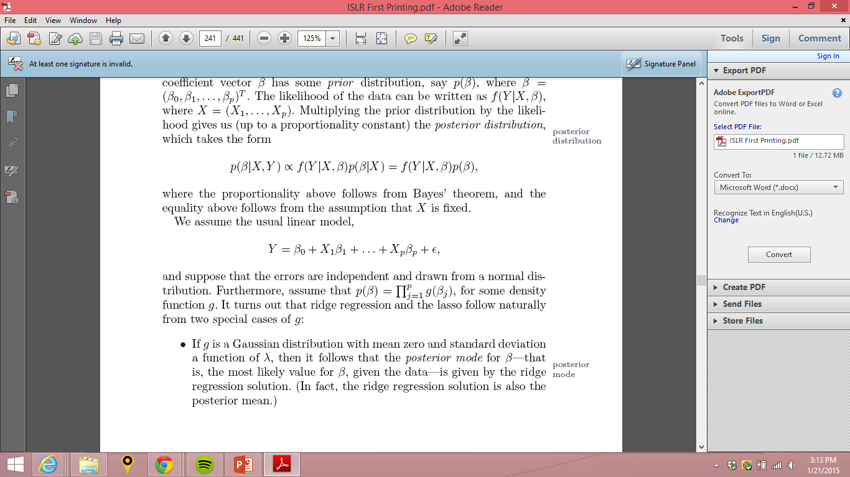
Bayesian point of view
In Bayesian theory, we assume p(β) has a prior distribution. Multiplying that prior by the likelihood gives us the posterior distribution.
If we assume then:
If g follows a Gaussian distribution with mean 0 and SD that is a function of λ then the most likely posterior value for β is the ridge regression solution
If g follows a Laplace distribution with mean 0 and a scale parameter of λ then the most likely posterior value for β is the lasso regression solution

Slide 19
Selecting the tuning parameter
Cross validation is a simple way to choose the best λ
Choose a grid of λ values and compute cross-validation error for each value of λ
Choose λ for which error is smallest

Slide 20
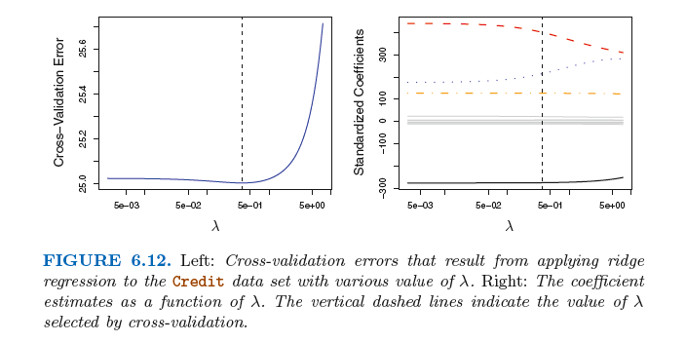
Example of cross validation

Slide 21
Lab important points
model.matrix()
Useful function that creates a matrix with all predictors and also transforms categorical variables into dummy variables
glmnet()
Has an alpha argument that determines what type of model is fit. If alpha=0 then a ridge regression model is fit, and if alpha=1 then a lasso model is fit
By default standardizes coefficients

